Slide 1

DriverPass System Analysis
Joshua Reyes
Notes:
[No speaker notes required for this slide.]

Slide 2

System Requirements
The system shall allow users to create accounts and log in
The system shall allow customers to schedule, cancel, and modify driving lessons
The system should be accessible on desktop and mobile devices
The system should load and respond within a few seconds
Notes:
[In your speaker notes, include an explanation of the different requirements you determined for DriverPass’s system. What are the functional requirements you selected to describe? What are the nonfunctional requirements you selected to describe? Be sure to explain how these requirements meet DriverPass’s needs.]

Slide 3
Use Case Diagram
Customers can create accounts and log in
Customers can schedule, cancel, or modify driving lessons
Customers can take online practice tests and view progress
Staff (secretary) can schedule lessons and manage customer information
Administrators can manage users, schedules, and system data
The system connects with the DMV to stay updated on rules and test content
Notes:
[Explain your diagram. Who are the different actors in the system? What are the different use cases? How did you account for DriverPass’s needs in your design? In your explanation, keep your audience in mind. Avoid the use of terms like “actors” and “use cases” in your explanation.]

Slide 4
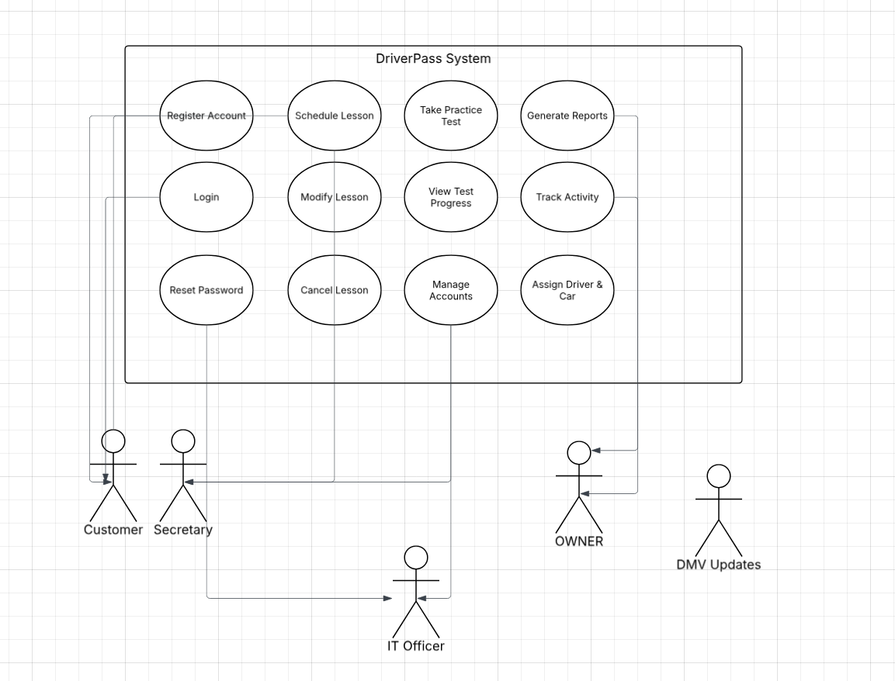
Activity Diagram
Notes:
[Explain your diagram. Which use case are you breaking down? What are the steps for this use case? How did you account for DriverPass’s needs in your design? In your explanation, keep your audience in mind. Avoid the use of technical terms such as “nodes,” “control flows,” and so on.]

Slide 5
Security
Secure login with username and password
Encrypted passwords to protect user data
Account lockout after multiple failed login attempts
Role-based access to limit what users can see and do
HTTPS used to protect data during transmission
Notes:
[How did you consider security in your design? In your explanation, keep your audience in mind by avoiding the use of technical terms.]

Slide 6
System Limitations
Requires internet access to function
Scheduling conflicts may still occur
Limited features based on time and budget
Does not include advanced features like real-time tracking
Notes:
[What are the limitations of your design? In your explanation, keep your audience in mind by avoiding the use of technical terms.]

